Slide 1
NVMeoF: Accelerator of Cloud Storage
Ren Qiaowei

Slide 2
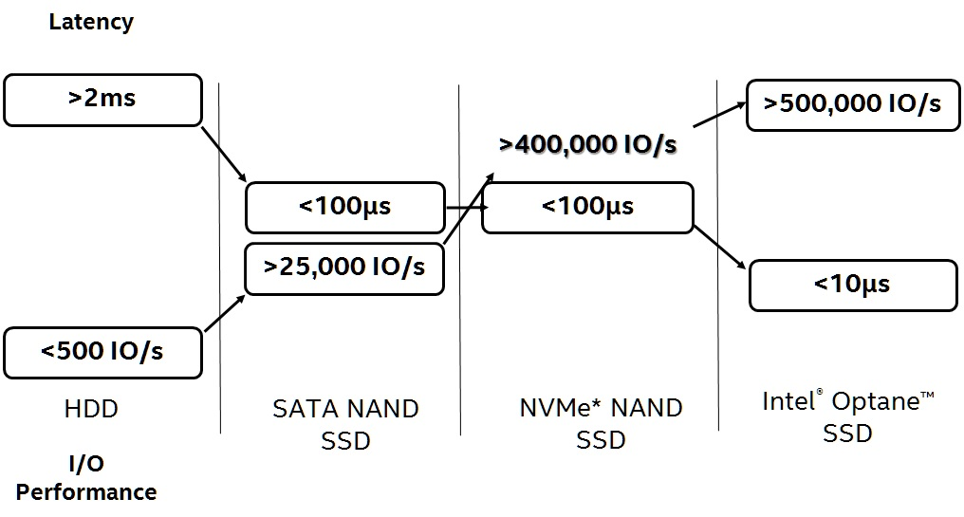
NVMe

Slide 3
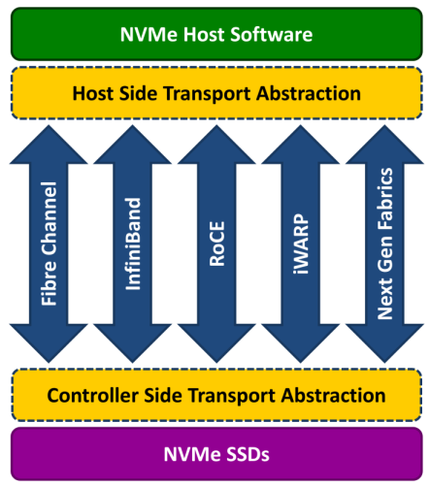
NVMeoF

Slide 4
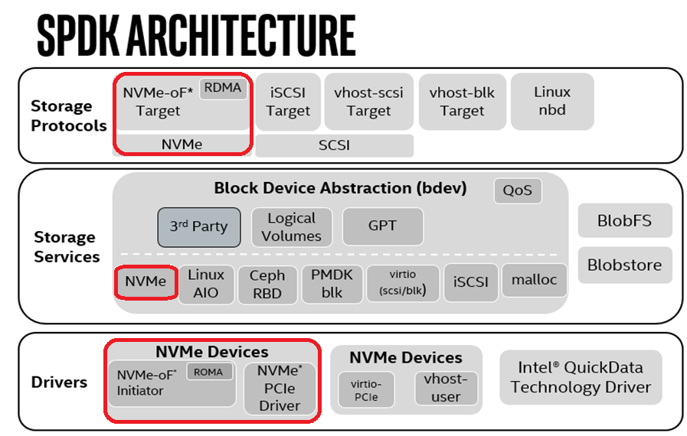
NVMeoF in SPDK

Slide 5
NVMeoF in Cinder
Compute(initiator)
Virtual Machine
3
read, write, etc. operations
QEMU/KVM
User
2f
Attach device to VM
OpenStack
Client
2a
Attach volume
Nova
os-brick NVMe-oF extension
Create/delete volume
send connector
with system-uuid and volume-identity
NVMe-oF Kernel Initiator
1a
Cinder
Cinder
Block Orchestration
2b
Create/delete volume on backend
1b
2d
send conn_info
Cinder Volume Driver (RsdDriver)
Create/delete Volume in Target
1c
REStful API
rsd-lib
RSM
2c
Identify rsd node, volume, and do endpoint attachment
Storage Mgmt
2e
Execute “nvme connect”
Storage(Target)
NVMe-oF Target
Fabric

Slide 6

NVMeoF in OpenSDS

Slide 7
Backup

Slide 8
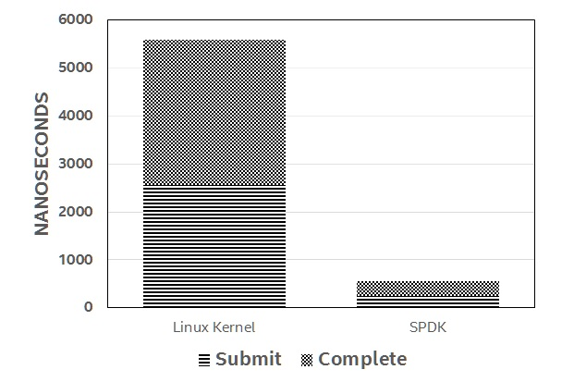
SPDK NVMe Performance
System Configuration: 2x Intel® Xeon® E5-2695v4 (HT off), Intel® Speed Step enabled, Intel® Turbo Boost Technology disabled, 8x 8GB DDR4 2133 MT/s, 1 DIMM per channel, CentOS* Linux* 7.2, Linux kernel 4.7.0-rc1, 1x Intel® P3700 NVMe SSD (800GB), 4x per CPU socket, FW 8DV10102, I/O workload 4KB random read, Queue Depth: 1 per SSD, Performance measured by Intel using SPDK overhead tool, Linux kernel data using Linux AIO

Slide 9
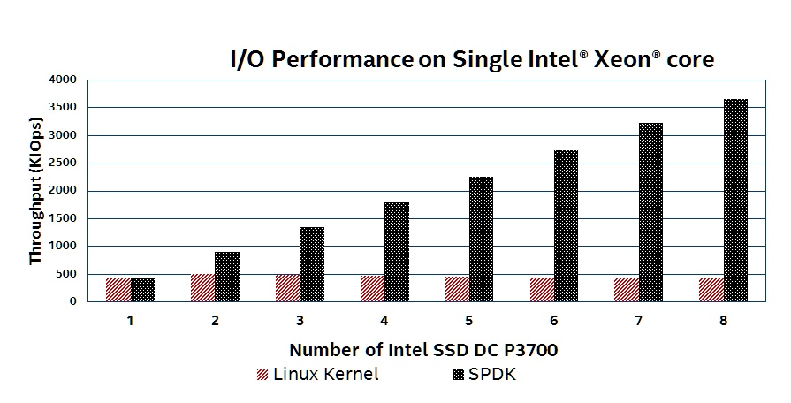
SPDK NVMe Performance
System Configuration: 2x Intel® Xeon® E5-2695v4 (HT off), Intel® Speed Step enabled, Intel® Turbo Boost Technology disabled, 8x 8GB DDR4 2133 MT/s, 1 DIMM per channel, CentOS* Linux* 7.2, Linux kernel 4.10.0, 8x Intel® P3700 NVMe SSD (800GB), 4x per CPU socket, FW 8DV101H0, I/O workload 4KB random read, Queue Depth: 128 per SSD, Performance measured by Intel using SPDK perf tool, Linux kernel data using Linux AIO

Slide 10







Intel RSD
Disaggregated
Composable
Interoperable
Intel® Rack Scale Design
Network
App 1
App 2
App 3
Single-Pane-of-Glass Management
Compute
Orchestration
Open Standard API
Compute
Intel Pod Manager
Vendor A Hardware
Compute
Composed Node 1
Compute
Vendor B Hardware
Storage Drawer
Composed Node 2
Vendor C Hardware
Accelerator Drawer
Vendor D Hardware
Buy less up front and Save money over time
Compose hardware resources “on the fly”
Choose the best now without vendor lock-in
OEMs* with solutions based on Intel RSD

